Slide 1
Assembly Language (Lab 5)
Let’s Organize Our Spaghetti Programs

Slide 2
Agenda
Stack Operations
Procedures
Definition
Call
CALL and RET Instructions
Built-in PROCs
Hands-on!

Slide 3
Stack

Slide 4
Runtime Stack
Runtime Stack is a temporary array (segment) in memory managed by CPU using SS and ESP registers.
We rarely manipulate ESP directly; instead we use PUSH and POP instructions (in addition to, other instructions like CALL, RET…).
ESP register points to the last (top) item in the stack, while SS register contains an index in the descriptor table like any segment register.

Slide 5
PUSH & POP
Push and Pop operations in the stack are reversed:
when an item is pushed, the ESP is decremented,
while when popping it is incremented.
This is an Intel design issue.

Slide 6
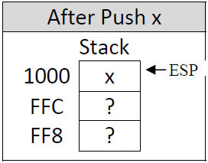
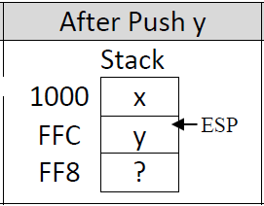
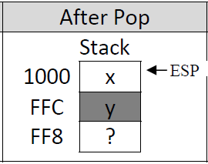
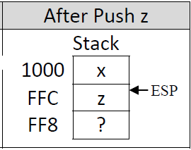
Example
Push values x and y, then pop a single element, then push a value z:

Slide 7
Stack Instructions
PUSH r/m16 | r/m32 | imm32
POP r/m16 | r/m32
PUSHAD / POPAD
PUSHFD/POPFD
Notes:
PUSH r/m16 | r/m32 | imm32: PUSH instruction decrements ESP first, then copies its operand into stack (the number decremented from ESP depends on operand size; 4 if double‐word operand and 2 if word operand)
POP r/m16 | r/m32: POP instruction copies the contents of the top element in the stack into its operand, then increments ESP (number incremented to ESP depends on operand size also)
PUSHAD: PUSH(All Double) instruction pushes all 32‐bit general registers into stack in the following order: EAX, ECX, EDX, EBX, ESP, EBP, ESI, and then EDI.
POPAD: POPAD(All Double) instruction popes all 32‐bit general registers from stack in the reverse order that PUSHAD pushes them (i.e. EDI, ESI, EBP, ESP, EBX, EDX, ECX, and then EAX)
PUSHFD/POPFD: PUSHFD/POPFD instructions pushes/popes 32‐bit EFLAGS register into/from stack

Slide 8
Stack Usage
Saving register values temporarily
Saving the return address of the called procedures
Passing parameters to procedures
Local variables defined in a procedure are created in its beginning and destroyed in its end
Notes:
Keeping the address of the function in stack before executing it to return to the beginnigof stack
F1()
{
return
}
Keeping the address of the f1 function before going to f2 in stack to know your beginning
F2()
{
return
}

Slide 9
Exercise: String Rev.
Write an assembly program that reads an input string, reverses it into another string and prints the reversed string.
Use stack!
Sample run:
Please Enter a string: Hello
The Reversed String: olleH
Notes:
Read input from user
Rev string using STACK (no proc yet)
Write output
After explaining PROCs, you can show them the difference that happened when we use PROCs in this code, for example.

Slide 10
Procedures

Slide 11
PROCs: the What & the Why…?
As we know, we should not write the whole program in a single chunk.
Program code should be divided into pieces, each piece:
performs specific function,
takes specific input, and
produces specific output.
We often called these pieces as functions or procedures, but it still has the same meaning.
Notes:
Use of functions:
Reusability: They allow us to reuse code instead of rewriting it
Testing: Functions allow us to test small parts of our program in isolation from the rest.
Abstraction: In order to use a function, you only need to know its name, inputs, outputs, and where it lives. You don’t need to know how it works, or what other code it’s dependent upon to use it.
Organization: As programs grow in complexity, having all the code live inside the main() function becomes increasingly complicated. A function is almost like a mini-program that we can write separately from the main program, without having to think about the rest of the program while we write it. This allows us to divide complicated tasks into smaller, simpler ones, and drastically reduces the overall complexity of our program.
Other advantages…

Slide 12
Procedure Definition
To define a procedure, use PROC and ENDP directives to encapsulate procedure code.
ProcName PROC
…
RET
ProcName ENDP

Slide 13
Procedure Call
To call a procedure, use CALL instruction, as follows:
CALL ProcName

Slide 14
exit
VS
ret
The main procedure does not require a RET instruction at its end, as it is ended by EXIT which terminates the whole program and returns to Windows OS. (exit is an alias for ExitProcess Windows API function).
In contrast, the user defined PROC must ended by RET instruction to allow return to the caller program.
If it is missed, the program continues execution to next machine code which it does not correspond to a valid machine instruction and causing a program crash

Slide 15
Example: SumArr
Let’s remember the code…

Slide 16
.data
Arr1 DWORD 10, 20, 30, 40, 50
sum_val DWORD ?
.code
main PROC
mov esi, OFFSET Arr1 ;put array address in esi
mov eax, 0 ;initialize eax by 0 for temp sum
mov ecx, LENGTHOF Arr1;initialize ecx (loop counter)
sum_loop:
add eax, DWORD PTR [esi]
add esi, TYPE Arr1 ;increment esi pointer by 4
loop sum_loop
call writeint ;output the sum (which already stored in EAX)
mov sum_val, eax
call CrLf
Notes:
Writing or not writing DWORD PTR will not make a difference at all.

Slide 17
Comments…
The whole program is inside the main which is a less organized program (Spaghetti)
What if I asked you to develop a code for sumArr2?
Imagine the same style with a very large project
It’s a real CURSE!

Slide 18
The Solution
Move the related logic into a separate blocks and call them when needed…
( Structured Programming – Like )

Slide 19
SumArr PROC Style
SumArr PROC
mov eax, 0
sum_loop:
add eax, DWORD PTR [esi]
add esi, 4
LOOP sum_loop
RET
SumArr ENDP
END main
INCLUDE Irvine32.inc
.data
Arr1 DWORD 10,20,30,40,50
.code
main PROC
mov esi, OFFSET Arr1
mov ecx, LENGTHOF Arr1
call SumArr
call WriteInt
call CrLf
exit
main ENDP

Slide 20
Call and RET Instructions… Deep Dive
What are the stack values before and after?
Notes:
Discuss:
Call, ret
Nested proc calls
Passing register arguments to procs

Slide 21
CALL and RET Instructions
CPU knows the next instruction by storing its address in EIP (Instruction Pointer) register.
So, at any time during the program run, EIP contains the address of next instruction to be executed
Therefore, to change the program flow by a jump or CALL instructions, CPU updates the EIP value to be the address of the jumped instruction or the address of the called procedure.

Slide 22
Questions…
How RET instruction knows the correct address to return to after a procedure end?
This can be accomplished by saving the return address (which is the address of the next instruction after CALL instruction).
Well, good answer, but where to save it?
The most suitable place to save the return address is the stack. Therefore, return address is pushed by CALL instruction and popped by RET instruction.

Slide 23
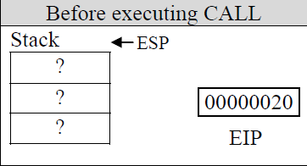
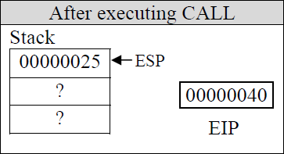
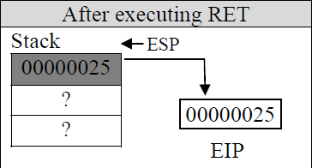
CALL and RET Affect Stack… HOW?
Address Code
main PROC
00000020 call MySub
00000025 mov eax, ebx
…
main ENDP
MySub PROC
00000040 mov eax, edx
…
RET
MySub ENDP
Notes:
Don’t forget to discuss:
Call, ret
Nested proc calls
Passing register arguments to procs

Slide 24
Code Like A Pro
Keep your code clean.
Add readable and clear documentation for each PROC:
;-----------------------------------------------
;Calculates: Sum of an integer array
;Recieves: ESI Contains the offset of the Array
; ECX Contains the length of the Array
;Returns: EAX contains Array Sum
;----------------------------------------------
SumArr PROC
Notes:
Description of PROC function
I/P params
O/P params
Possible preconditions (requirements)

Slide 25
Using Built-in Functions

Slide 26
Built-in PROCS - Reading
call readChar
AL
}
call readInt
call readDec
call readHex
EAX
{
EDX
call readString
ECX
EAX
Notes:
readString:
EDX: (input) offset of a string to write in
ECX: (input) set to the maximum number of characters the user can enter, plus 1 (to save space for the terminating null byte)
EAX: (output) procedure returns the count of the number of characters typed by the user

Slide 27
Built-in PROCS - Writing
call writeChar
AL
}
call writeInt
call writeDec
call writeHex
EAX
call writeString
EDX
Notes:
writestring:
EDX: offset of the null-terminated string to write

Slide 28
Built-in PROCS - General
call dumpRegs
call crlf
See your book for a lot more!

Slide 29
Hands On
Let the fun begin :D…

Slide 30
String Merge
Given 2 strings, merge the strings together using procedures and the stack, pop them back merged into a new string, and print the new merged string using: call writeString
Strings are defined as (static):
Sample output:
str1 BYTE "Hello", 0
str2 BYTE "World", 0
mergedStr BYTE (lengthof str1 + lengthof str2 - 1) DUP(?)
HWeolrllod
Notes:
Required: Only 1 PROC to merge the strings (besides main PROC)
//////////////////////////////////////////////////////////////////////////////
include irvine32.inc
.data
str1 byte "hello",0
str2 byte "world",0
dest byte lengthof str1+lengthof str2 -1 dup(?)
.code
main proc
mov eax,0
mov esi,offset str1+lengthof str1-2
mov edi,offset str2+lengthof str2-2
mov ecx,lengthof str1-1
l1:
mov eax,[edi]
push eax
mov eax,[esi]
push eax
dec edi
dec esi
loop l1
mov ecx,lengthof dest-6
mov edi,offset dest
l2:
pop eax
mov [edi],eax
mov eax,[edi]
call writechar
pop eax
mov [edi+1],eax
mov eax,[edi+1]
call writechar
inc edi
loop l2
exit
main endp
end main

Slide 31
Index Removal in Same Array
Write an assembly program that uses procedures and the stack: 1) to read an DWORD array of 10 elements from the user, 2) then read a 0-based index to remove from the array. 3) Using the stack, remove the element at that index from the array, 4) then move the modified array into the original array and print the modified array.
Sample run:
Enter 10 elements: 1 2 3 4 5 6 7 8 9 10
Enter the 0-based index to remove: 3
Output array: 1 2 3 5 6 7 8 9 10
Notes:
Required PROCs (besides main PROC):
1) readArr
2) writeArr
3) removeInd

Slide 32
Questions?

Slide 33
Thanks!

